Slide 1
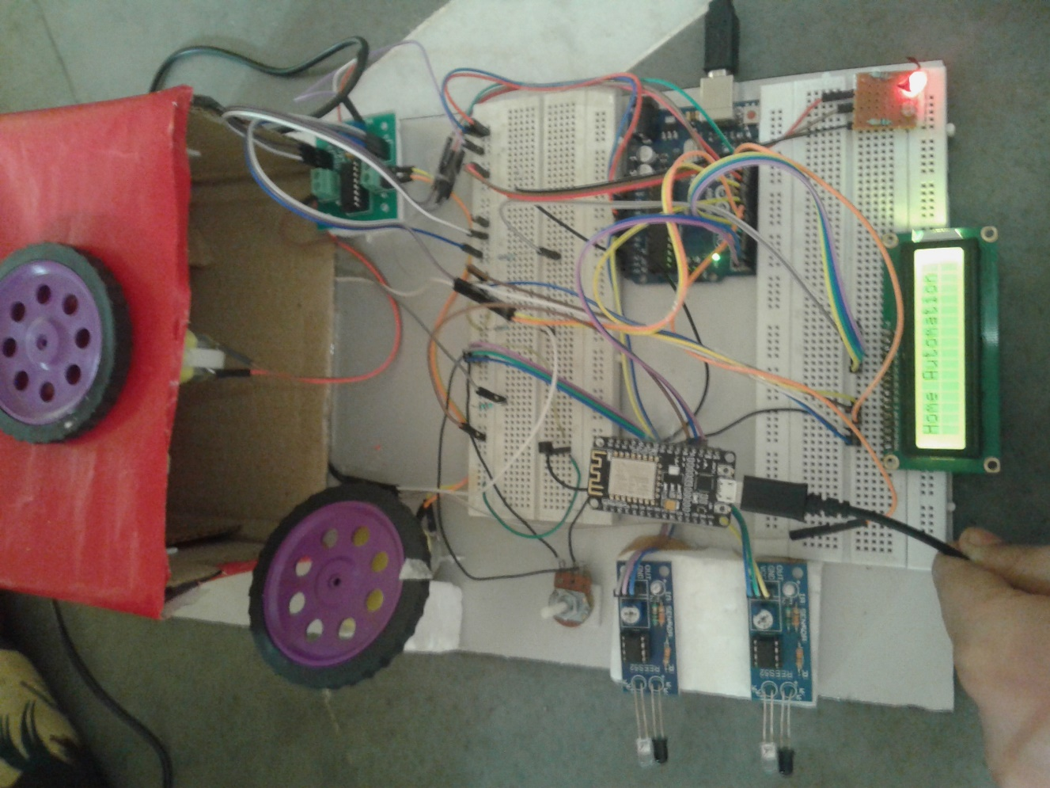
ROOM AUTOMATION
GROUP MEMBERS
UTKARSH
PAWAN
ASHUTOSH
KUNAL

Slide 2
TECHKRITI -2K17 IIT-KANPUR Problem statement Event-Ecdc(Embedded)
To design a miniaturized home automation system. Explanation: The project must have the following features ▸A centralized unit consisting of a display and a Wi-Fi module, connected to at least two home appliances (like Motor, LED, etc.). ▸ A user interface in laptop or any other device (e.g., Python terminal can be directly used for the same) ▸A two way communication between the centralized unit and the user interface using Wi-Fi. ▸You should be able to command the central unit, using the user interface, to switch ON/OFF the devices instantly OR set an alarm for the same.

Slide 3
Components used
Arduino uno
Esp8266 NodeMCU Wifi Module
16x2 LCD
IR Sensors,LDR Sensor
Temp sensor(LM 35)
Motor Driver IC L293d
LEDs
Breadboard
Motors
Connecting Wires

Slide 4
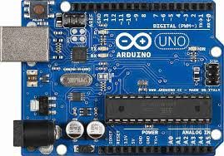
ARDUINO UNO
Arduino Uno is a microcontroller board based on the ATmega328P. It has 14 digital input/output pins (of which 6 can be used as PWM outputs), 6 analog inputs, a 16 MHz quartz crystal, a USB connection, a power jack, an ICSP header and a reset button.
It acts as the brain of the circuit. All the devices are controlled using it.
Motor
ESP-8266(NODE MCU) WIFI MODULE
LED’S
LCD
SENSORS (LDR ,IR ,TEMPERTATURE)

Slide 5
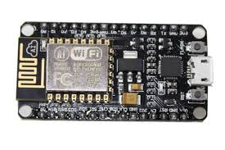
ESP -8266
ESP8266 WiFi Module has an Integrated TCP/IP protocol stack that can give any microcontroller access to your WiFi network. The ESP8266 is capable of either hosting an application or offloading all Wi-Fi networking functions from another application processor.
It creates a platform for the serial communication between the arduino and itself. The user provides the command which is being read by the esp8266 and send to arduino via serial communication which executes all the processes.

Slide 6
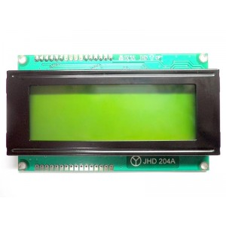
LCD DISPLAY
A liquid-crystal display (LCD) is a flat panel display, electronic visual display, or video display that uses the light modulating properties of liquid crystals. Liquid crystals do not emit light directly. LCDs are used in a wide range of applications including computer monitors, televisions,instrument panels, aircraft cockpit displays, and signage.
The LCD utilized displays the following things :-
Room temperature
Total no. of person present in the room
The last action performed using the USER INTERFACE is displayed on the LCD screen

Slide 7
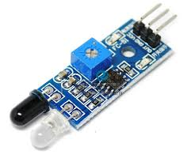
sensors
LDR is light dependent resistor for controlling the loads based on the intensity of light. When light falls on the sensors its resistance varies . They are often used as light sensors.
IR sensors IR (Infra Red) sensor is, as the name suggests, used for sensing the infrared light. It is not used to transmit IR, but to measure it. IR has LED and light sensor. When IR light falls on the area surrounded by wavelength of IR sensor, LED blows, indicating that there is IR light.
Temperature sensors The LM35 is an integrated circuit sensor that can be used to measure temperature with an electrical output proportional to the temperature (in ºC)

Slide 8
INTERFACE
TEMPERATURE SENSOR
LDR SENSOR
IR SENSOR
WIFI Module
ARDUINO
GATE
LED
VARIABLELED
FAN
LCD
DISPLAY

Slide 9
Detailed explaination of model
As soon as we switch on the device, the LCD displays the temperature of the room. When someone tries to enter the room the IR sensors sense it and open the gate, which is later closed automatically after the person has entered the room. These sensors also detect the total no. of people present in the room and displays it on screen.
When someone enters the room ,the fan is switched ON and its speed varies depending on the no. of people present in the room. Also, the person sitting in the room can change the speed of the fan manually . The Arduino gives logic to the motor driver ,the motor driver is connected to MOTOR which in turn runs the fan.
The LDR sensor senses the intensity of light in the room and glows accordingly . If the intensity is high, the LED will glow dim and bright if the room is dark. Room is provided with another led which can be switched ON and OFF manually using the user interface .

Slide 10
INNOVATIVENESS
We have the room with a fan whose speed varies according to the no. of people in the room.
Instead of using Switch we have provided the user with USER INTERFACE for manual control of the speed of fan .
We have provided the room with an LDR for automatic control of intensity of light.

Slide 11
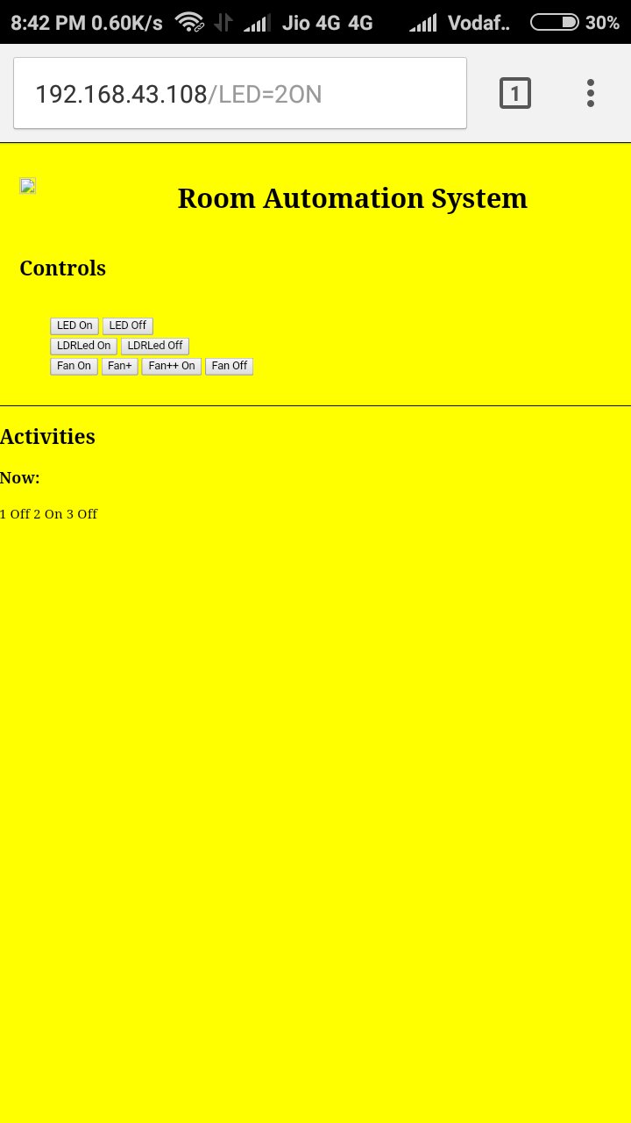
USER INTERFACE
The wifi network established through esp8266 helps us to give commands through android or windows device.This creates the user interface.The user interface will let us enable the following parts whose status would be consecutively displayed on the LCD screen:
LED
FAN(SPEED)
Then the esp8266 send the commands to the arduino using serial communication. Then the Arduino uno commands the devices to work according as the user commands.

Slide 12
EFFECTIVENESS & POWER CONSUMPTION
Rotating speed of the fan is being varied by number of persons entering the room. Lesser the number of people lower is the fan speed hence consuming less power.
The led, in high intensity light glazes dim and bright in low intensity light with the help of LDR sensor.
So in this way we reduce power consumption

Slide 13
COST ANALYSIS
Arduino Uno- 500
Esp 8266 NodeMCU Wifi Module-470
Motor Driver IC L293D- 100
Motors- 50
16x2 LCD - 120
IR Sensors- 100
LDR Sensors- 20
Temp Sensor[LM35]- 50
Jumper wires- (M-M,M-F,F-F)- 120
Total Cost- 1530

Slide 14
THANK YOU

